Slide 1
Lecture 1
By: Hassan Khamis
Software Engineer At Trianglz

Slide 2
Outlines
Introduction
Main Components
  Activities
  Services
  Broadcast receivers
  Content Provider
Activity Life Cycle
Layouts
  Linear Layout
  Constraint Layout

Slide 3

Introduction

Slide 4
Main Components
Activities
  An activity represents a single screen with a user interface , in-short activity performs actions on the screen.

Slide 5
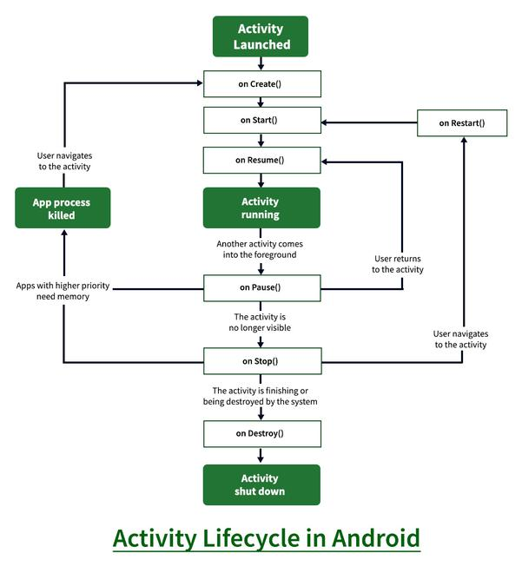
Activity Life Cycle

Slide 6
Activity Life Cycle
Cases
  When Close App
  When Click Back Button
  When Click Home Button
  When Dialog Appear
  When Rotate Device

Slide 7
Main Components
Services
  A service is a component that runs in the background to perform long-running operations. for example, a service might play music in the background while the user is in a different application, or it might fetch data over the network without blocking user interaction with an activity.
  Types:
    Foreground
    Background
    Intent
    Bound

Slide 8


Main Components
Broadcast receivers

Slide 9
Main Components
Content provider
  A content provider component supplies data from one application to others on request. Such requests are handled by the methods of the content resolver class. The data may be stored in the file system, the database or somewhere else entirely.

Slide 10
Main Components
Content provider
  A content provider component supplies data from one application to others on request. Such requests are handled by the methods of the content resolver class. The data may be stored in the file system, the database or somewhere else entirely.

Slide 11
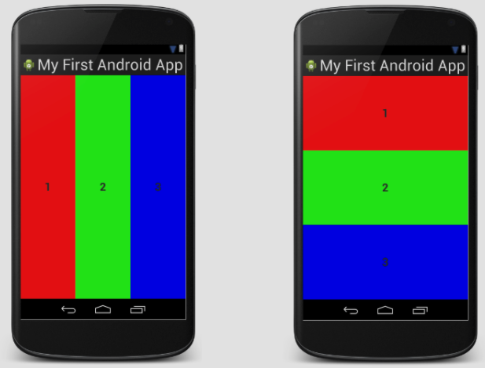
Layouts
Linear layout

Slide 12
Layouts
Constraints
  Percentage
  Match constraints
  Baseline
  Barrier
  Guidelines
  Chains
  Bias

Slide 13
Thank you

